Slide 1
C# Workshop
Selenium Test Automation
Maciej Wyrodek

Slide 2
Workshop Plan
Programming basics.
Programming Concepts.
Automation basics.
Test automation Design.

Slide 3
Day 1 - Programming Basics
1. Visual Studio and its functions
2. data types, variable, methods, etc
3. Programming

Slide 4
What are your goals?
What do you want to learn?

Slide 5
Why do Testers need to know how to code?

Slide 6
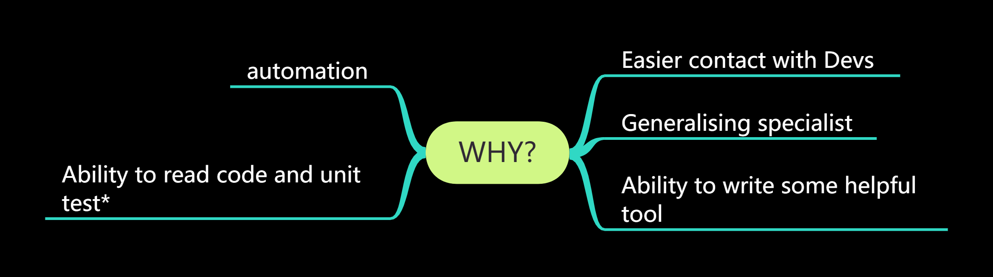

Slide 7
YOU NEED A MENTOR!

Slide 8
YOU NEED A MENTOR!
The 4-day workshop is just a start on your journey,

Slide 9
What I will help you with:
I will get you enough knowledge to start.
I will point you where to find more info.
I will point you where to start.
I will help you get some practice

Slide 10
GIT

Slide 11

EX 1 - Setup Git
1. Ho to GitHub com and created your account (you can delete it later)
2. Go to https://github.com/mwyrodek/csharp_workshop
and fork it
3. Install git extensions
4. Clone your fork

Slide 12
Fork
The fork is a copy of a repository. Forking a repository allows you to experiment and changes without affecting the original project.

Slide 13
Commit vs push
Open your local copy of repository
Open readme
Add some info there.
Commit it (commit not push) to your repo.
Go to your fork on GitHub.
Check if your text is in a readme.
Push your changes.
Check now.

Slide 14
Revert commit
Do some changes to readme.
Commit your changes
Open your previous commit in git extension.
Revert your branch to that..
Check file content

Slide 15
Revert
Revert allows you to return to previous commits
revert is not recommended on already Pushed changes!

Slide 16
Commit Often
push only when you are ready!

Slide 17
Branches
create new branch
Commit and push some changes
Switch back to master branch.

Slide 18
Branches
Branches are useful for experiment and working on many tasks at once.
For example, branch per developer or per task/story.

Slide 19
Branches
Add fork of your friend as remote repository
Commit and push some changes
Try to marge his readme changes with yours.
both make conflicting changes to readme
try to merge now.

Slide 20
Commit Often
push only when you are ready
But oush to your branch/fork
before leaving work

Slide 21
Let’s talk about programing!

Slide 22
Open VS!

Slide 23
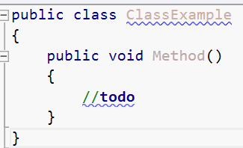

Slide 24
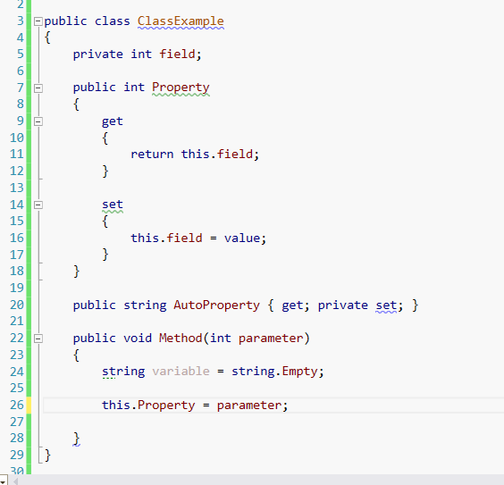

Slide 25
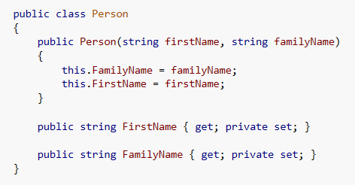

Slide 26
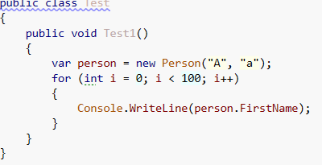
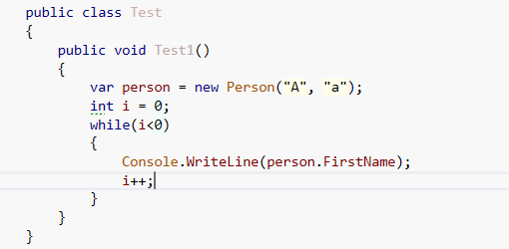

Slide 27
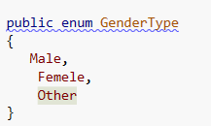
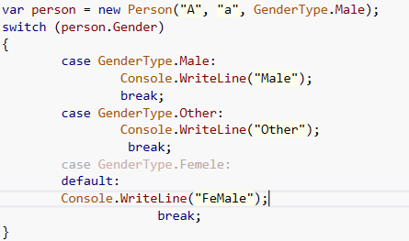
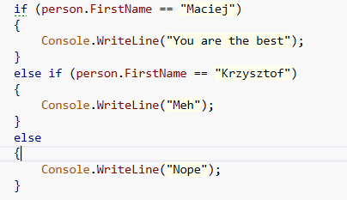

Slide 28
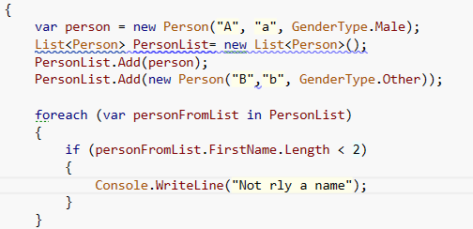

Slide 29
Object-oriented Programming

Slide 30
Pillars of OOP
Abstraction
Encapsulation
Inheritance
Polymorphism

Slide 31
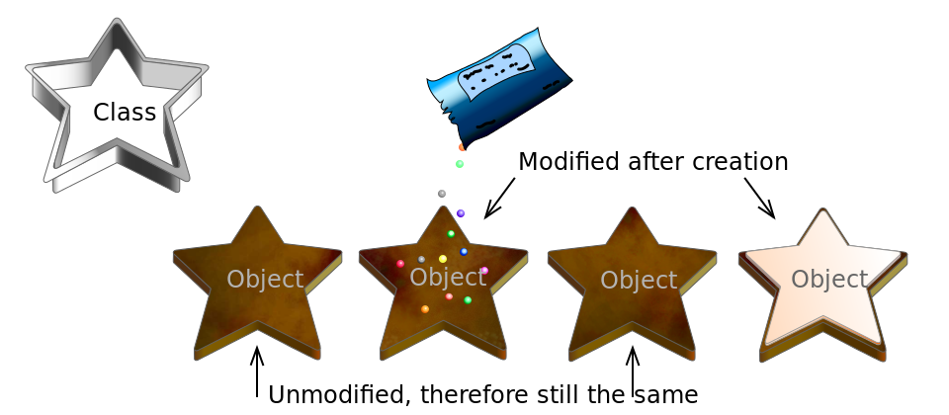
Class and Object

Slide 32
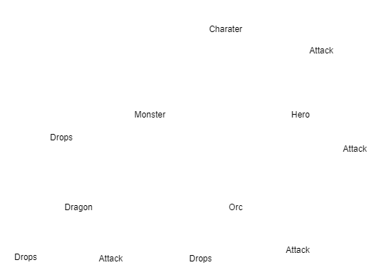
Abstraction

Slide 33
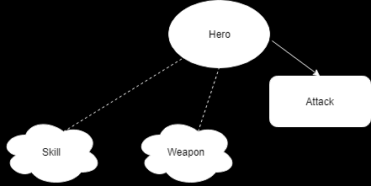
Encapsulation
Attack = Skill + Weapon

Slide 34
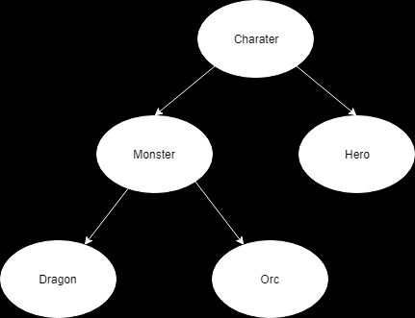
Inheritance

Slide 35
Polymorphism
loot = Dragon.Loot()
loot = Orc.Loot()

Slide 36
SRP - Single Responsibility Principle

Slide 37
DRY- Don’t Repeat Yourself

Slide 38
TDD - Test Driven Development
Write Test
Run test
Write code
Run Test
Fix code

Slide 39
TDD - Test Driven Development
Write Test
Run test
Write code
Run Test
Fix code

Slide 40
Let’s Talk about Automation!

Slide 41
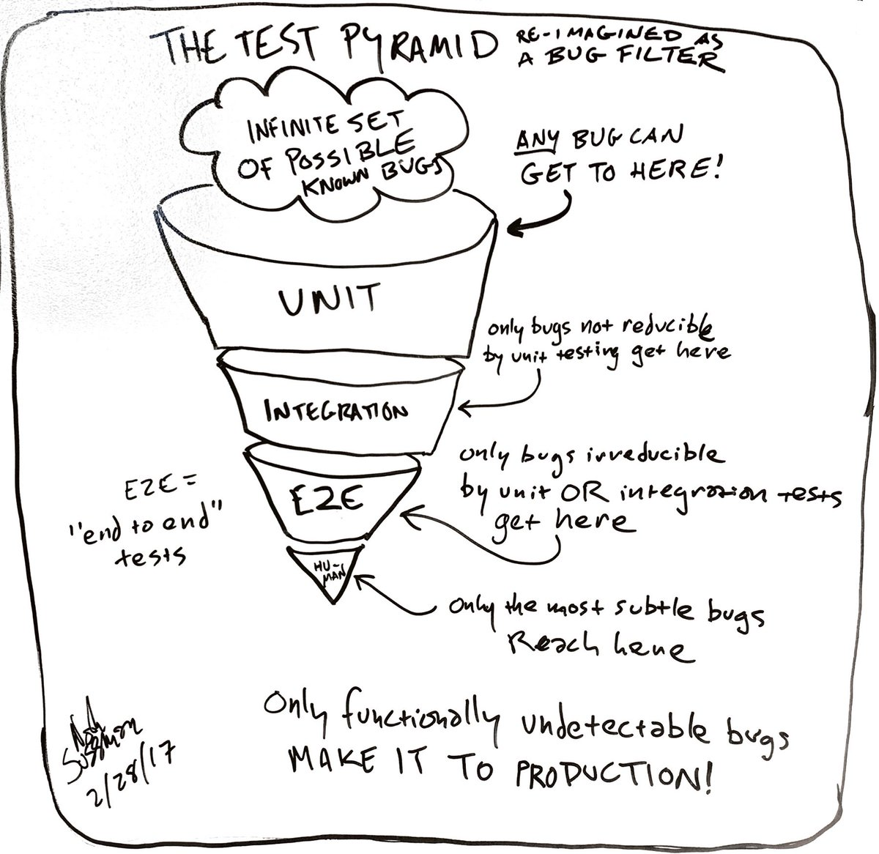

Slide 42
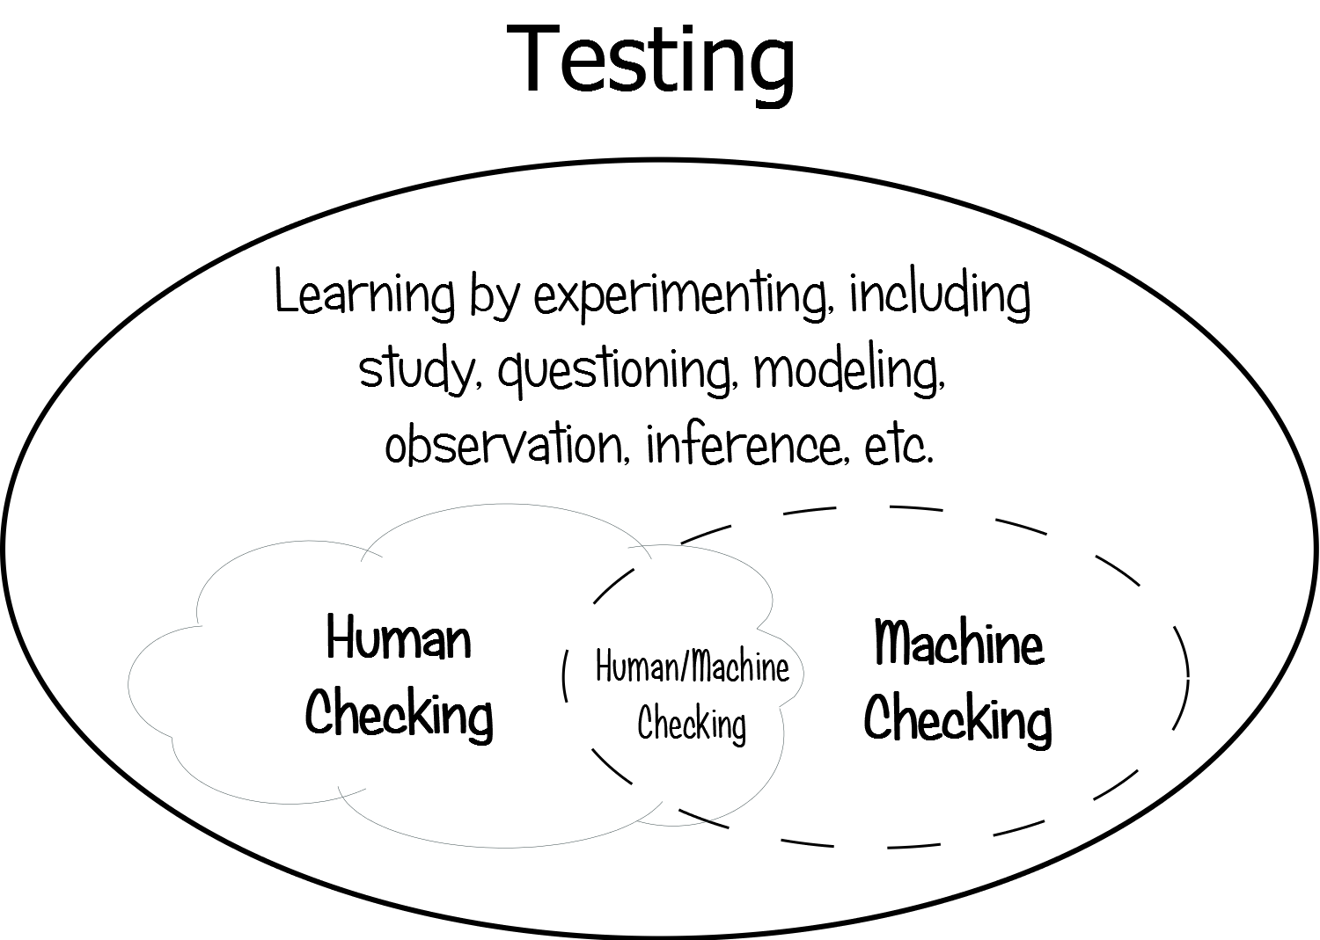

Slide 43
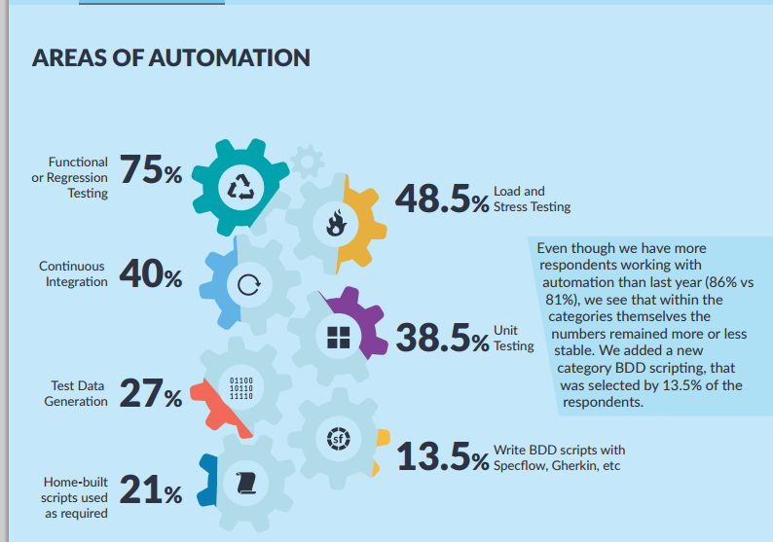

Slide 44
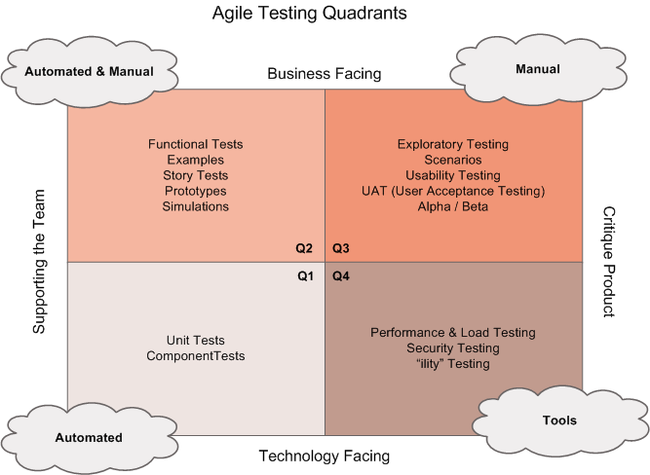

Slide 45
See Red After you’ve seen Green

Slide 46
Don’t invent wheel a new!
Use already existing frameworks

Slide 47
SELENIUM WEBDRIVER

Slide 48

SELENIUM WEBDRIVER

Slide 49
Example: https://github.com/ObjectivityLtd/Test.Automation
https://atata-framework.github.io/
https://github.com/TestStack/TestStack.Seleno (discontinued)
http://redwoodhq.com/
https://gauge.org

Slide 50
WEBDRIVER Standard:
https://www.w3.org/TR/webdriver/

Slide 51
LOCATORS
https://automatetheplanet.com/selenium-webdriver-locators-cheat-sheet/

Slide 52
Locator Order
ID
CLASS/NAME
CSS Selector
XPATH

Slide 53
PAGE OBJECT PATTERN

Slide 54
Materials you can use

Slide 55
What I will help you with:
Computer Science Fundamentals:
https://online-learning.harvard.edu/course/cs50-introduction-computer-science
Wstęp do programowania w C#, Anna Kempa, Tomasz Staś
http://c-sharp.ue.katowice.pl
C#. Praktyczny kurs. Wydanie III, Marcin Lis, wyd.3, wyd. Helion
C#. Ćwiczenia. Wydanie IV, Marcin Lis, wyd. Helion
Channel9 online courses
Classe sand methods description at MSDN: http://msdn.microsoft.com/pl-pl/library/system.net(v=vs.110).aspx
docs.microsoft.com
msdn.com

